Slide 1

A Smart Assistive System for Cervical Cancer Patients
By MIST_Constants
Team members :
Nazia Shehnaz Joynab
Fairooz Nawar Nawme
Sazia Tabasum Mim
A.S.M. Rakibul Hasan

Slide 2
Problem Statement
Cervical cancer is the 4th most common cancer among women worldwide and it is the 2nd most common cancer in Bangladesh. According to the International Agency for Research on Cancer, more than 50 million Bangladeshi women are at risk of developing cervical cancer.

Slide 3
Servey Q/As of The Problem
Q_1 : Do you know about Cervical Cancer?
A_1 :
60%
40%
NO
YES
Q_2 : If you are asked to do an initial screening test, will you go for it? what are the possible reasons you wouldn’t go for it?
65%
35%
A. Afraid of taking screening test
A_2 :
NO
YES
B. Shyness
20.9%
37.2%
41.8%
C. Lack of Information
A
B
C

Slide 4
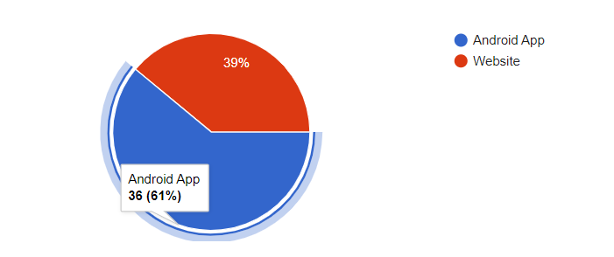
Servey Q/As of The Problem
Q_3 : If we develop a digital platform about Cervical Cancer what is your preference of the platform?

Slide 5
Our Inspiration
- Most of the women are not comfortable to speak about their problems. - Many are afraid of taking initial screening test. - People face problem in getting specific information about doctors and hospitals. As a result, we propose an android app named CervivorBD. A smart assistive system for cervical cancer patients. The app will be developed in Bengali so that mass people in BD can be made aware of cervical cancer.

Slide 6
Our Solution
Android based mobile application which provides vast information about Cervical Cancer to ensure awareness. It has four modules.
01
02
Awareness
Initial Screening
Various information about Cervical Cancer is provided here
Initial Screening is done using machine learning,which may provide a solution on the problem of shyness
03
04
Doctor’s Appointment
Online Forum
List of doctors and hospitals are provided on the basis of location .User can take appointment through this app.
User can have a discussion on their problems and can ask various question which will be answered by specialized doctors and also other users.

Slide 7
Technology used
Language :
- python for creating and training ML model
- Dart for developing android app
Frontend Framework : Flutter
Backend : Cloud Firestore

Slide 8
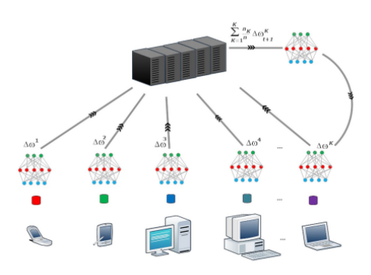
Future Work
1. Will use federated learning while taking initial screening test while will ensure the security of the provided data.
- In federated machine learning, each client (organization, server, mobile device, and IoT device) has a dataset and his local machine learning model.
- There is a centralized global server in a federated environment that has a centralized machine learning model (global model), which aggregates the distributed client’s model parameters (model gradients).
- Each client trains the local machine learning model locally on a
dataset and shares the model parameters or weights to the
global model.
- The global model makes an iteration of rounds to collect the
distributed clients model updates without sharing raw data.

Slide 9
Federated machine learning enables us to overcome the obstacles faced by the traditional machine learning model as:
• Traditional machine learning occurs by moving all data sources to a centralized server to train and build the model, but this may violate the rules of military/hospital organizations especially when a third-party is used to create, train and maintain the model.
• To train the model, the third-party should prepare, clean, and restructure the data to be suitable for model training, however, this may violate data privacy when the data are handled to create the model.
• Traditional machine learning models also take much time to build the model with acceptable accuracy, which may cause a delay for organizations, especially recently opened ones.

Slide 10
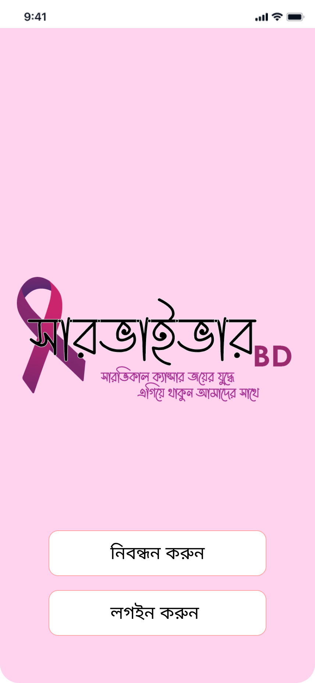


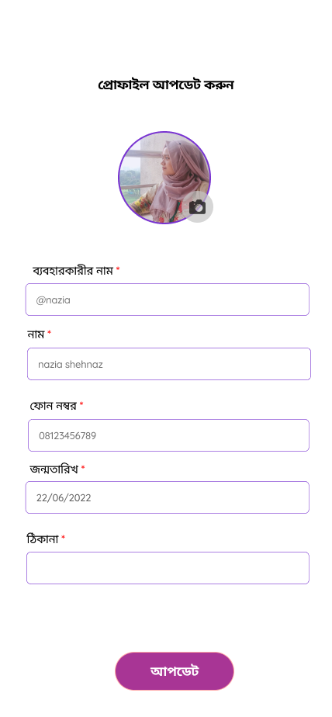
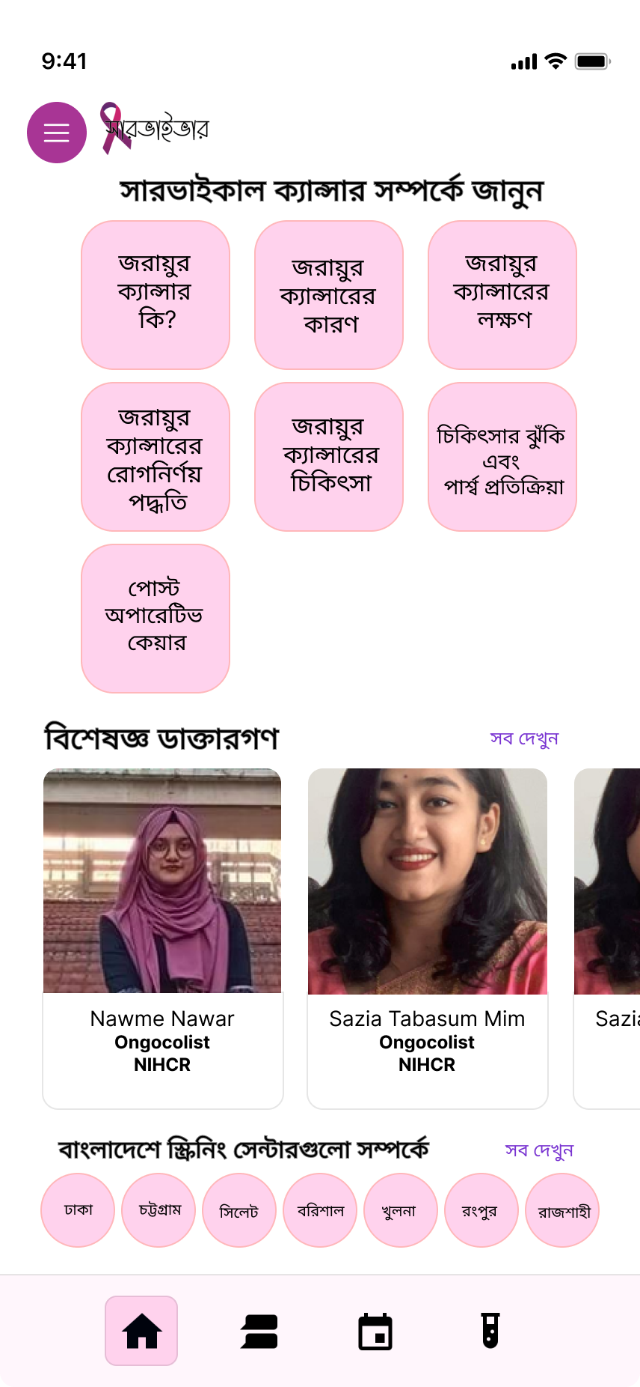
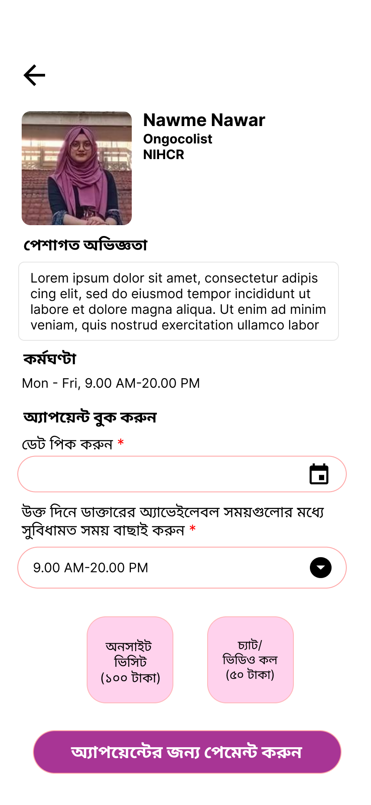
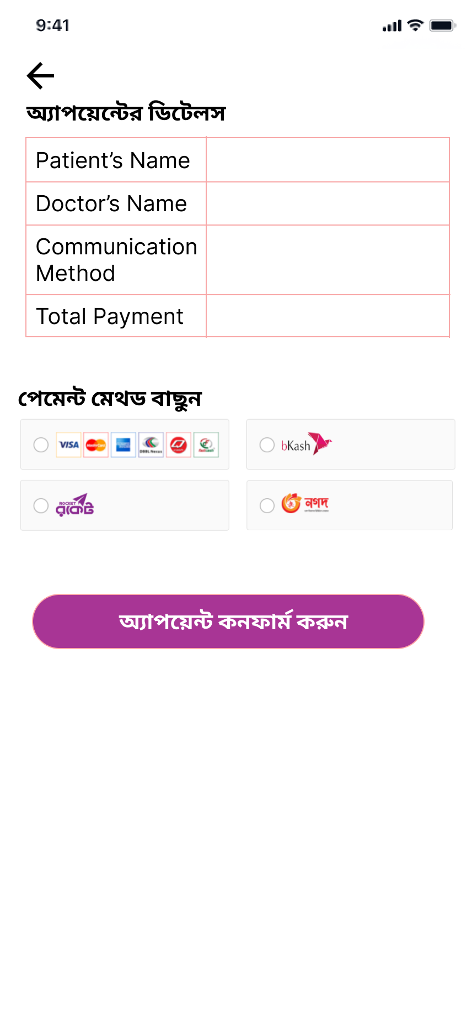
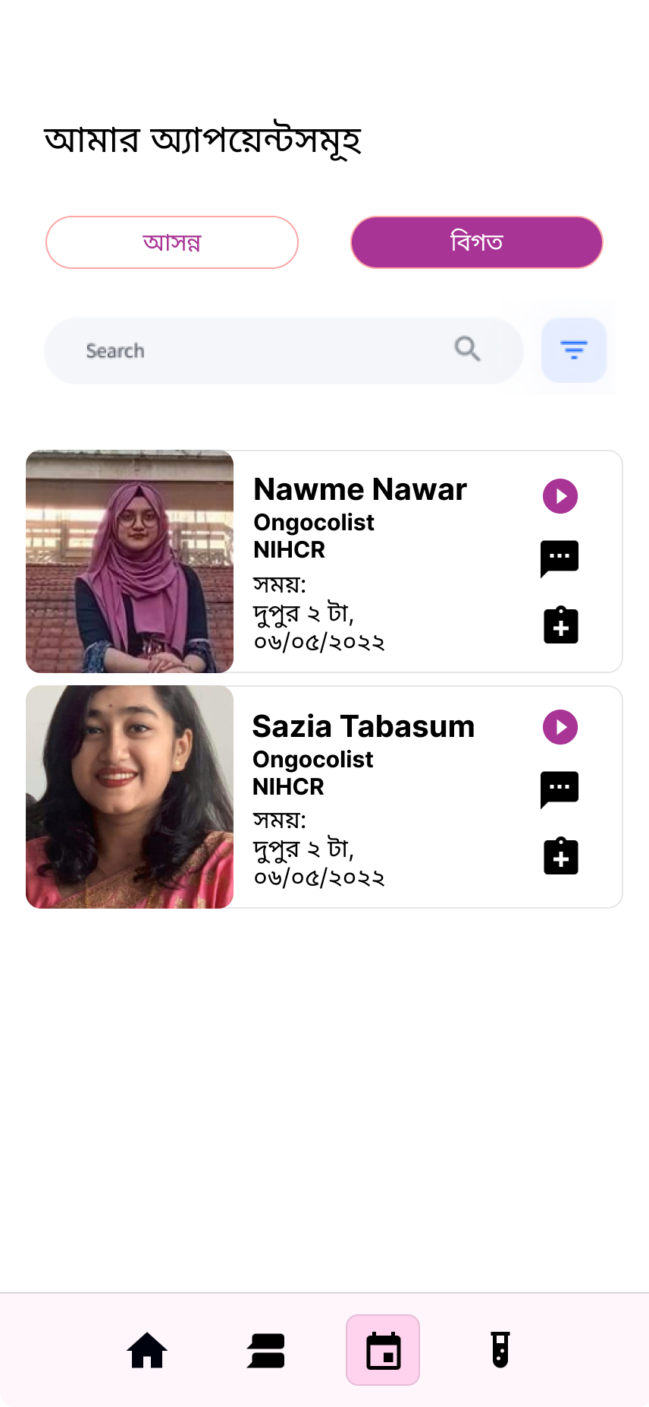
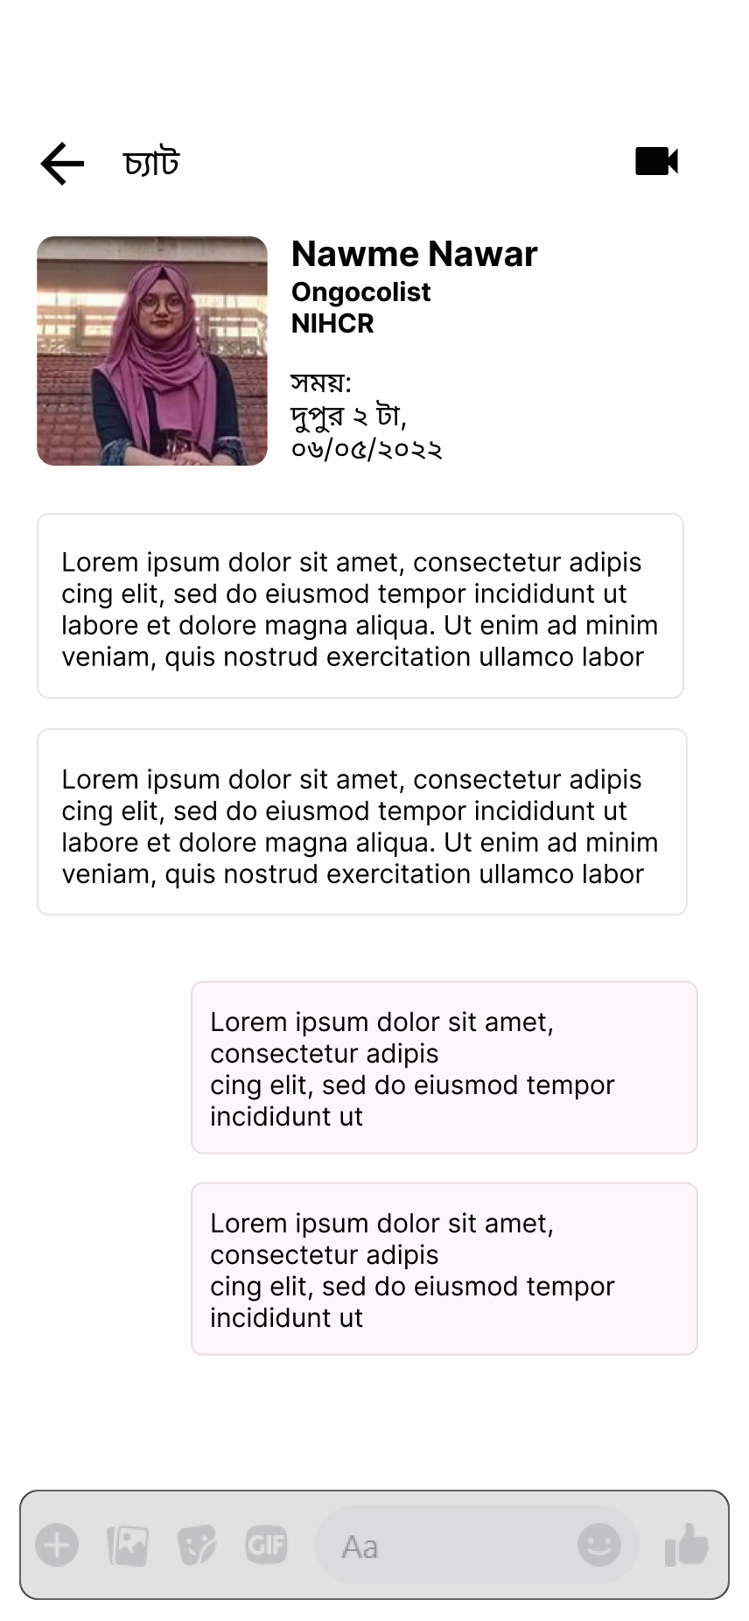
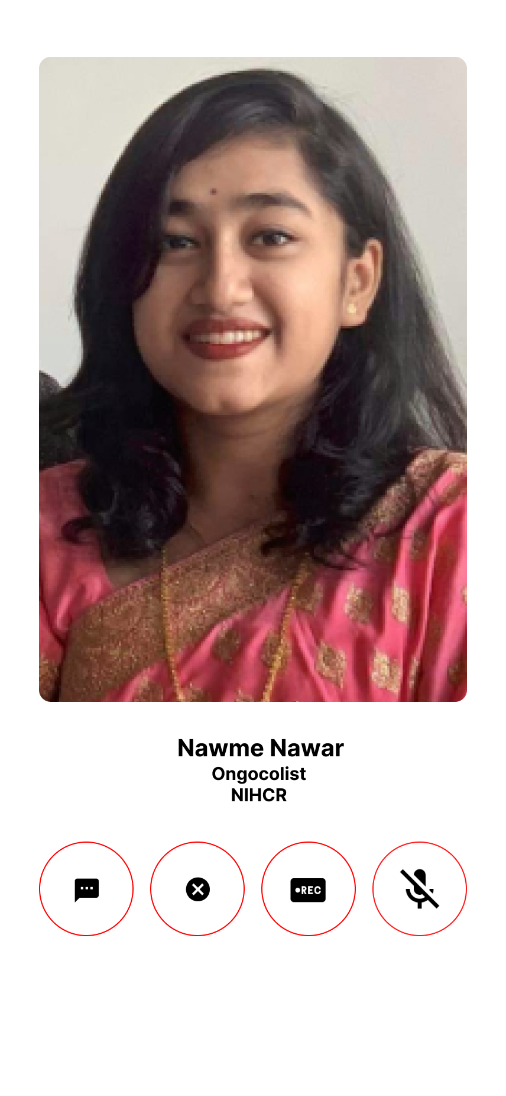
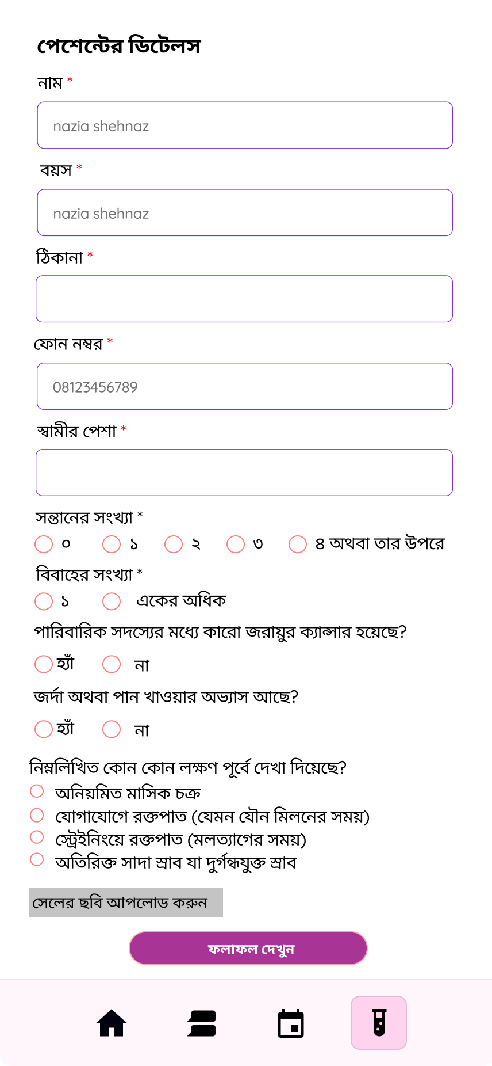
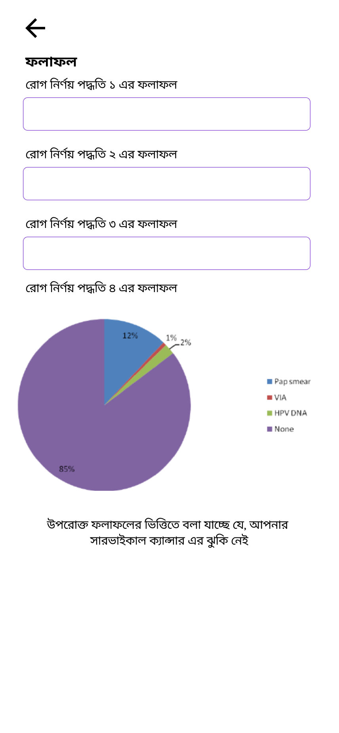
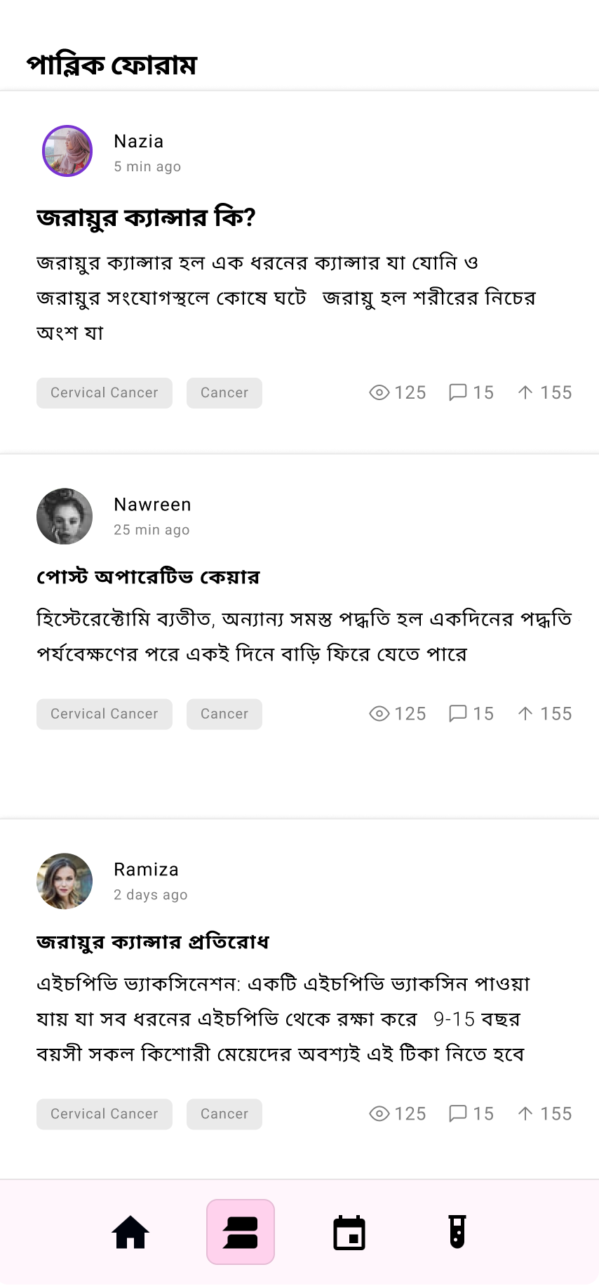
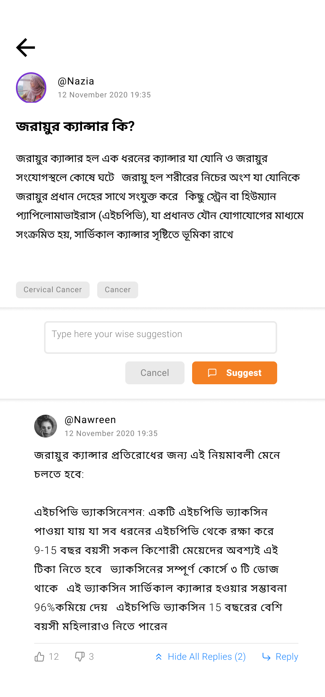
Prototype of the App

Slide 11
